Slide 1

REPRODUCIBILITY IN RESEARCH – And REPRODUCIBLE ANALYTICS
session 5 – TRMD 8080 Advanced Molecular Epidemiology Methods
Notes:
Image credit Wickham and Grolemund

Slide 2
RESEARCH
Google Define Results
Noun: “the systematic investigation into and study of materials and sources in order to establish facts and reach new conclusions.”
Verb: “investigate systematically.”
https://tinyurl.com/y5tw8zaj
In computation and statistics:
“The full software environment, code, and data that produced the results”
DEFINITIONS

Slide 3
REPRODUCIBILITY
What do you think this means?
THEORY

Slide 4
REPRODUCIBLE RESERACH
Modern term usage originate in Computer Science
Might be more akin to “transparency” than to ensuring “truth”

Slide 5
New LEXICON
Methods Reproducibility
detailed study protocol
measurement procedures - SoPs
data gathered
data used for analysis with descriptive metadata
analysis software and code
the final analytical results
how key reagents and biological materials were created or obtained
The “note books”
Goodman, Fanelli and Ioannidis

Slide 6
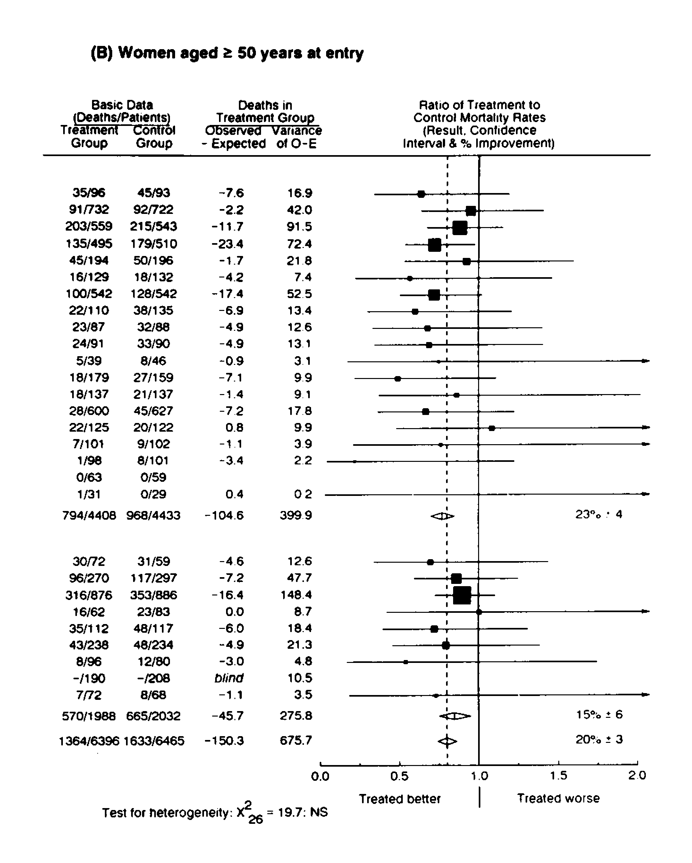
New LEXICON
Results Reproducibility (maybe replicability)
BEWARE VOTE COUNTING IN META-ANALYSIS! (TAMOXIFEN)
This isn’t the same as a bunch of studies that are “statistically significant” or not
Goodman, Fanelli and Ioannidis

Slide 7
New LEXICON
Robustness and generalizability
Goodman, Fanelli and Ioannidis

Slide 8
METHODS Reproducibility
Scripts should be written such that, with no changes to data
1) Starting from a clean session they can be run and get the same results every time
II) They can be run by someone other than you and produce the same results
III) They can be run on a machine which is not yours and produce the same results with NO changes.
MonteCarlo Simulation / processes that involve generation of random/pseudo-random numbers provide an extra challenge here.
The broader perspective is that others should be able to read, understand and recreate your results exactly using the materials and documentation that you leave behind.
Practice as relates to statistical computing/working with DATA

Slide 9

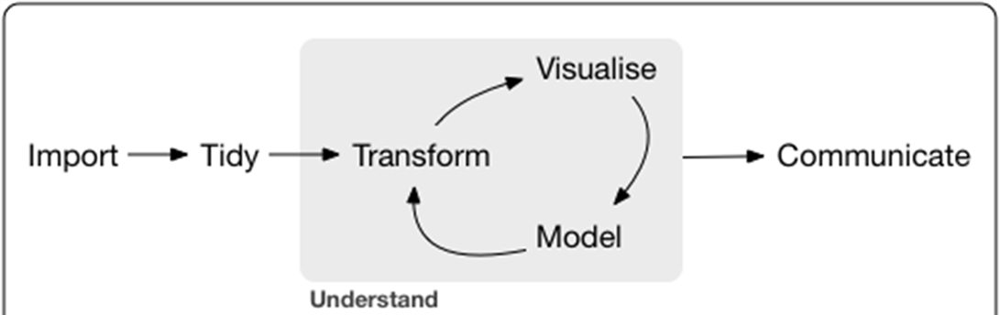
WORKFLOW
Sync Backup
Version control: git
Standardized Workflow and Software Stack
Facilitates Reproducibility
Instills Best Practices for coding
Builds good habits of documentation
Enhances your ability to communicate and share results to others
SQL, Python, Java, R etc..
Python, R, STATA, SAS
Markdown, LaTeX, Jupyter notebooks, html, shiny, etc…

Slide 10
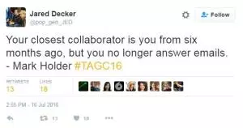
Workflow
Document!
Everything is a text file
All files are human readable (gets complicated with Images and sounds)
Explicitly tie files together
Plan to organize, store and disseminate
We work with scripts.
This are readable text files, that will give instructions to various pieces of software on how to import, clean/tidy, transform, analyze, visualize, model and communicate our results.
We use formal version control software and conventions to maintain current versions of all code, documentation and communications as well as history of previous iterations and documentation of changes and facilitate collaboration
This is done (often) using the git language/software
We never change the real original data.
Everything is auditable.
Practically

Slide 11
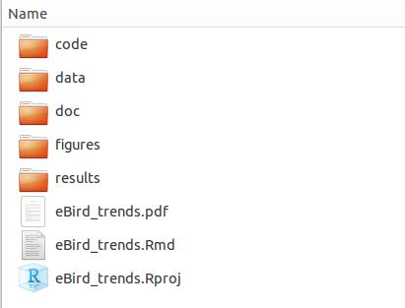
Reproducible Research addenda
Other advice:
https://guides.lib.berkeley.edu/c.php?g=652220&p=4575532
Project/directory structure is critical
Some types of development (e.g. writing R packages, require specific project directory structures)

Slide 12
REPRODUCIBILITY
Reproducibility is a scientific ideal –
Theoretical reproducibility
Experimental reproducibility
Measurement reproducibility
Analytic reproducibility
Interpretation reproducibility
“Replication crisis”
Other alternative lexicons THEORY

Slide 13
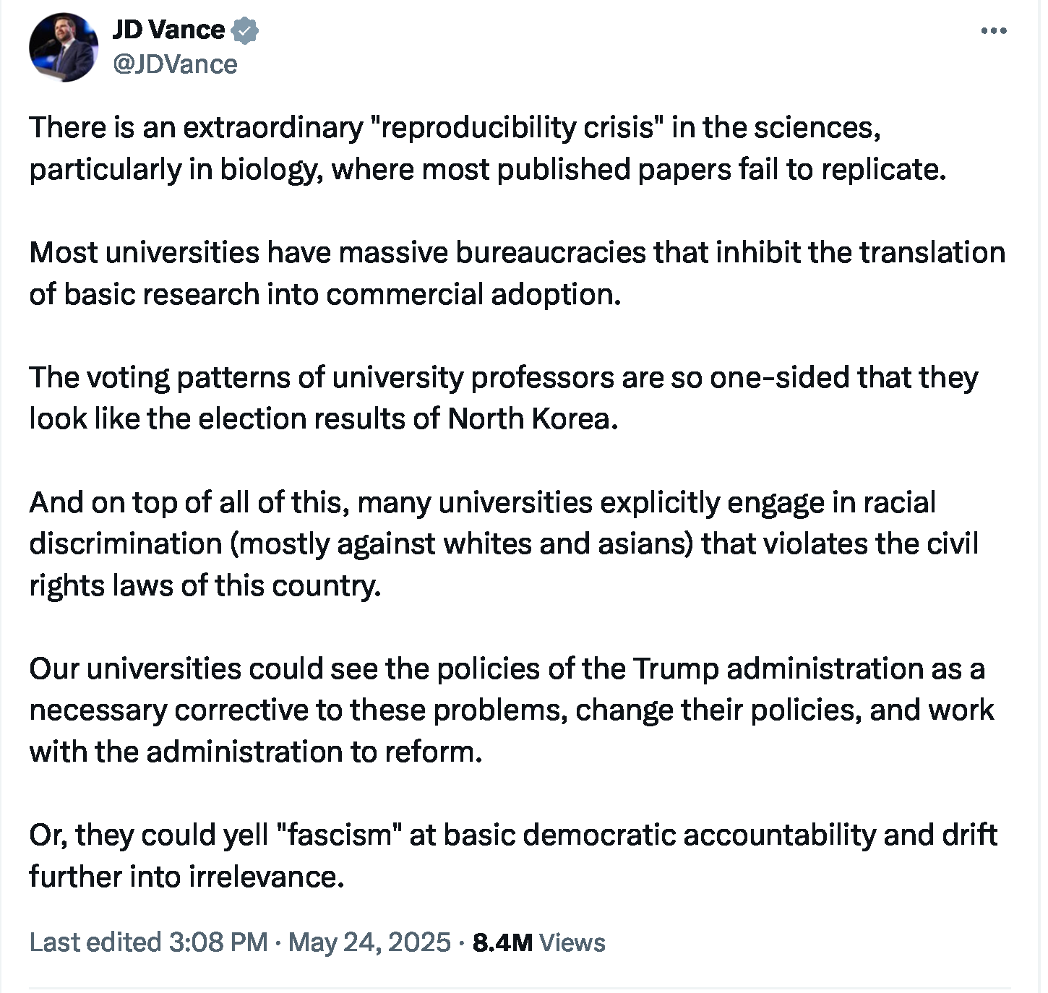
REPRODUCIBILITY
Other alternative lexicons THEORY

Slide 14
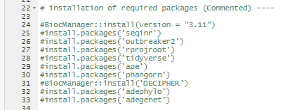
Practical Applications
First steps are to get Rstudio installed and loaded and install relevant packages.
Bioconductor, seqinr, outbreaker2, rprojroot, tidyverse, ape, phangorn, DECIPHER, adephylo, adegenet
A use example of reproducible workflow in R
Reading and writing sequence data in FASTA and binary formats
Multiple sequence alignment
Phylogenetic tree construction
Outbreak reconstruction

Slide 15
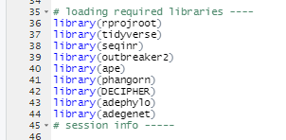
Loading Packages
library() and require()
Packages in R contain mainly additional functions and data to extend R functionality
Must be loaded in each session (or environment changed)
Load at start of the project (near front of do file)

Slide 16
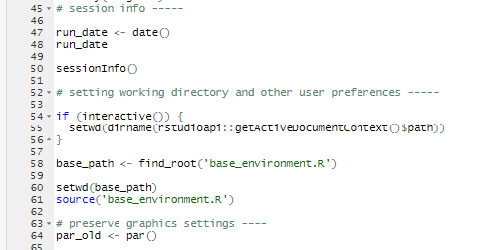
Working directories
Default search directory and location for writing files.
Can specify other directories relative to this.
Ideally working directory is set such that it is transferred across machines
Storing and printing date of run of file a good idea
Preparation of working directory (I use ‘rprojroot’) and ‘rstudioapi’
base_environment.R - file can be used to add additional functions and environmental variables.
source() – takes and ‘parses’ R input from a file in the given environment

Slide 17
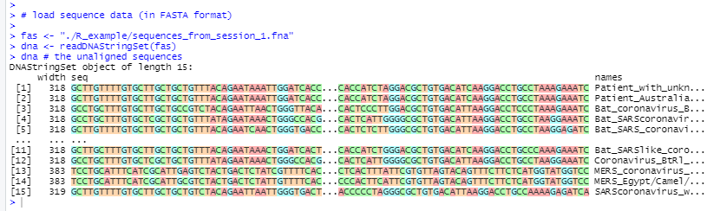
Reading Sequence data
File formats –
FASTA
Binary
FASTQ
EMBL
Etc…
https://www.genomatix.de/online_help/help/sequence_formats.html
Examples from class one are stored in a text file in FASTA format
Use in this case readDNAStringSet() which is loaded by the Biostrings package (loaded by DECIPHER package – and maybe others)
Note varying widths of each sequence

Slide 18
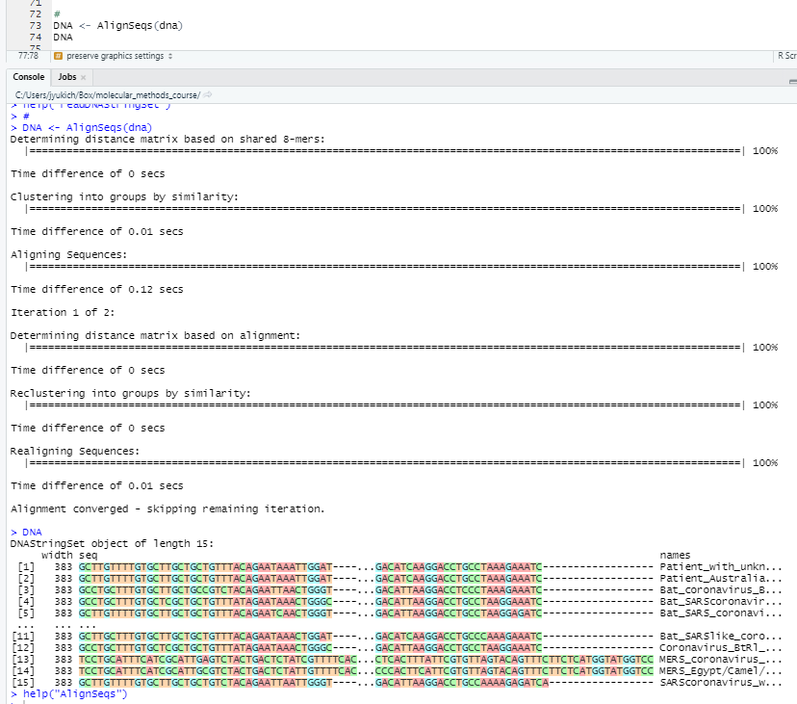
DECIPHER
Example of package that does multiple sequence alignment
Using a known or developing phylogenetic tree in process
AlignSeqs() function can be used to do this.
Multiple sequence alignments often tweaked by hand but this process.
Ensure record of manual changes kept in script too

Slide 19
Making A Phylogenetic Tree
Distance –
Trees based on minimizing distance between sequence differences
Easy, fast but not based on biological or evolutionary theory
Often good starting point but not necessarily best final point
Parsimony –
Based on theory that similar sequences arise from common ancestry
therefore simplest explanation of changes in sequence are the correct one
Likelihood –
Statistical inference of probability a tree arose given an evolutionary model
Hardest to implement
To root or not too root:
Without a rooted tree direction of change is ambiguous
Out-group rooting

Slide 20
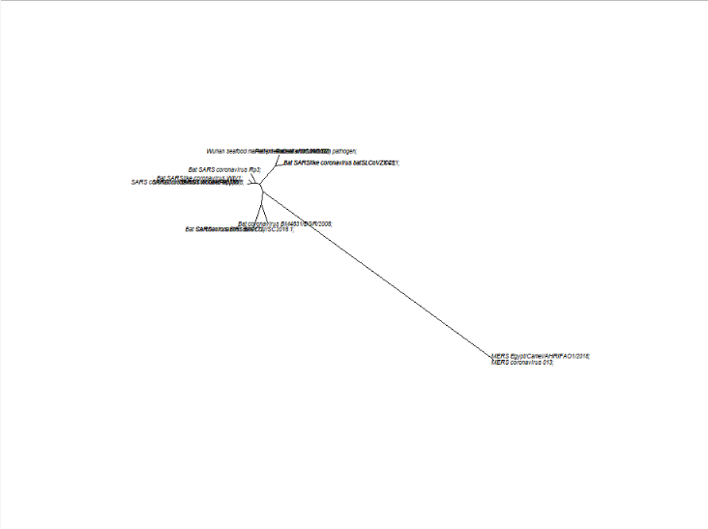
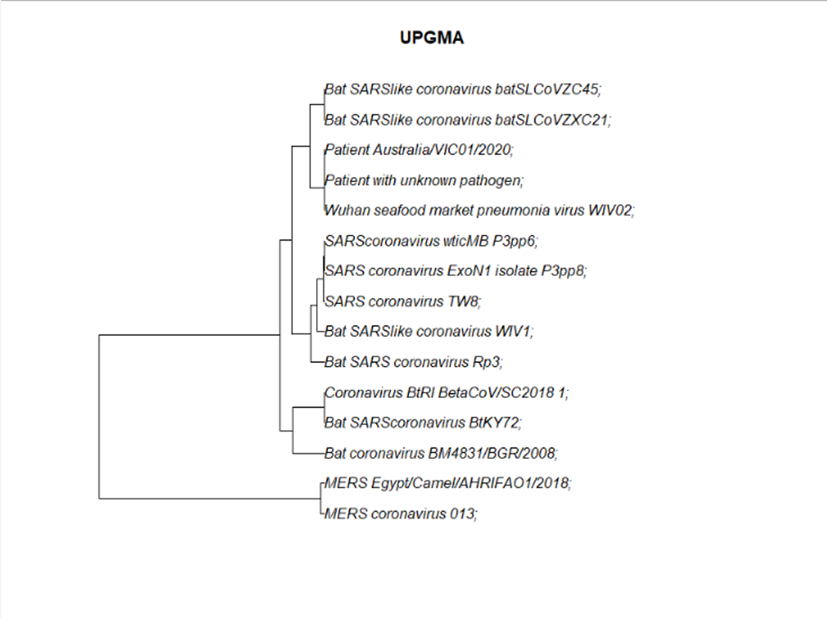
Rooting
unrooted tree on left
Rooted tree on the right
Rooting not always necessary, but many hypothesis require
Done by including outgroup sequences (which are they here?) Why?
Can be done with gene duplicates as well, how?

Slide 21
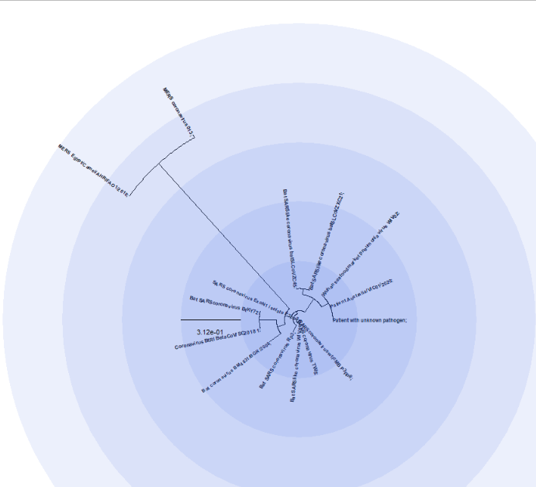
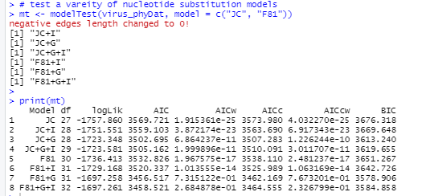
pICK A Tree (NOT JUST ANY TREE)
modelTest – in phangorn package can be used to fit multiple nucleotide substitution models
And compare

Slide 22
OUTBREAKER2
Reconstruct epidemics based:
on contact matrices
Symptom onset/sampling time
Disease knowledge
Genetics
Bayesian Inference
R package for outbreak reconstruction integrating epidemiological approaches and genetic data
http://www.repidemicsconsortium.org/outbreaker2/

Slide 23
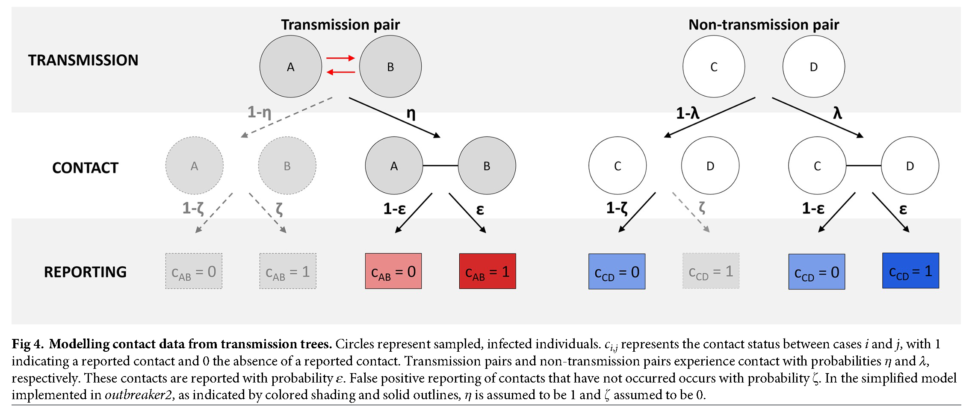
outbreaker2
R package for outbreak reconstruction integrating epidemiological approaches and genetic data
http://www.repidemicsconsortium.org/outbreaker2/

Slide 24
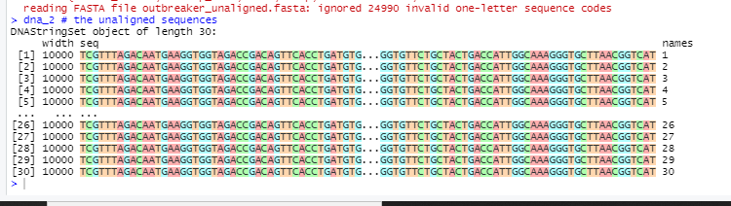
outbreaker2
R package for outbreak reconstruction integrating epidemiological approaches and genetic data
http://www.repidemicsconsortium.org/outbreaker2/
Before we do the inference lets take a look at the genetic sequences in the fakeoutbreak data set
We can follow same procedure to read them, convert to FASTA formats, Align them and reconstruct a phylogenetic tree

Slide 25
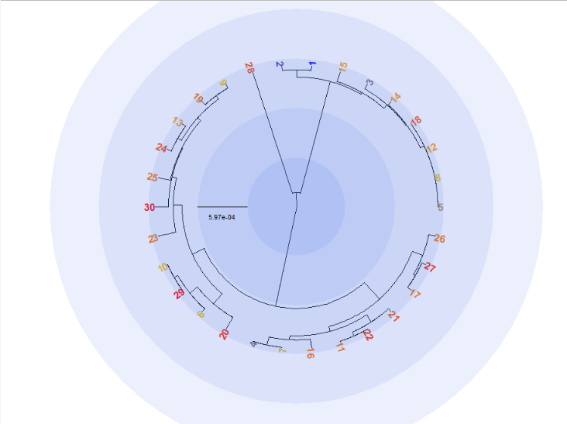
Proposed PHYLOGENETIC TREE
Procedures used here are included in the R script
Note the outlier (28)
As well as two distinct branches

Slide 26
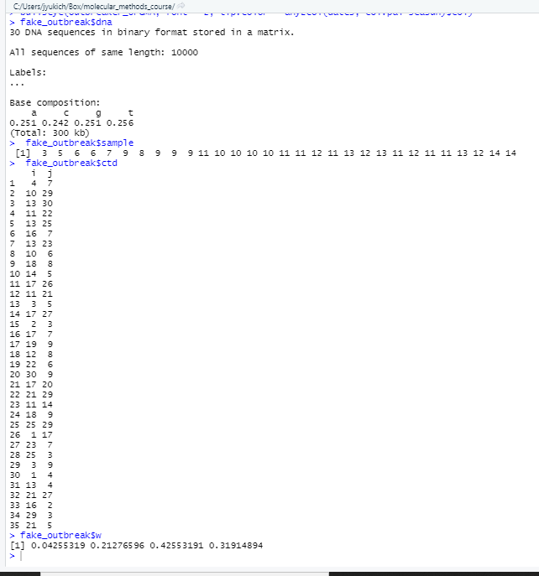
OUTBREAKER2
What does a dataset look like:
Dna we just saw
Sample (says since day 0 that sample was collected) – corresponds to ascertainment of case in this example
Ctd – matrix of contacts
W – empirical generation time distribution

Slide 27
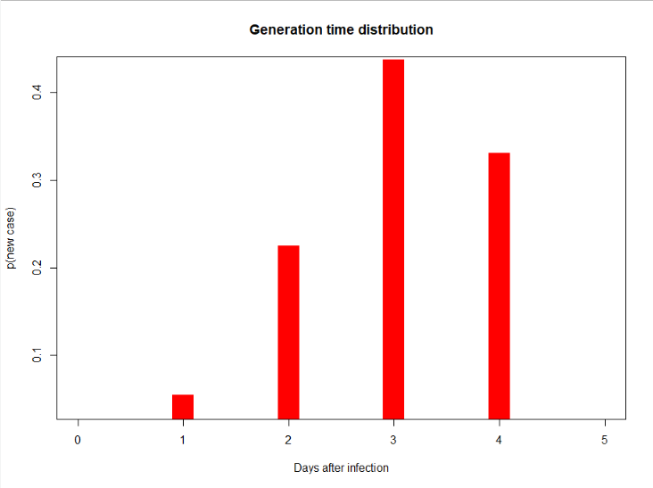
Generation time distribution
Generational interval (expected time from infection to serial infection)
Different than serial interval (expected time from symptoms to symptoms) – or between case ascertainment

Slide 28
PSUEDO – RANDOM NUMBER GENERATORS
Many computer programs/analyses/processes require the generation of “random” numbers
This is typically done through the use of a Pseudo-random number generator (e.g. Mersenne twister)
True random number generators harvest entropy from nature – e.g. radioactive decay
Numbers are not truly random, but for all intents and purposes are indistinguishable from random number sequences
This has advantages and disadvantages
They are not really random. – serial correlation/repetition
Can be predicted if you know the algorithm and seed
Since they are not random they can be made truly reproducible by ‘setting the seed’

Slide 29
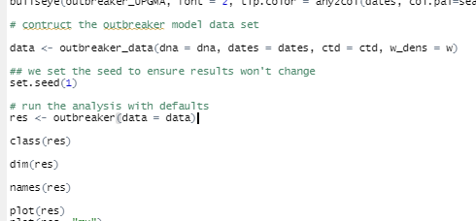
Fit the MODEL
Use the outbreaker() function – Not a lot of excitement here.

Slide 30
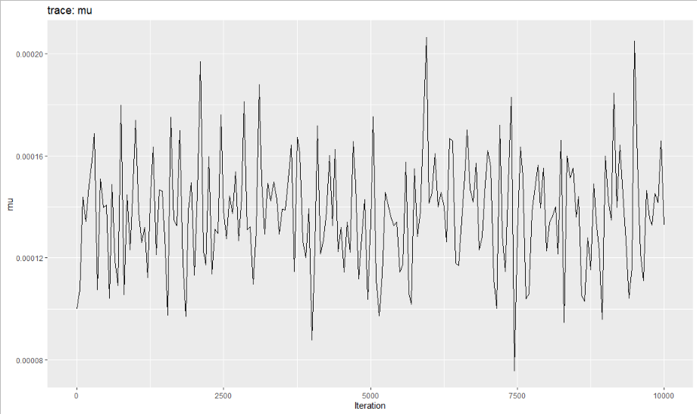
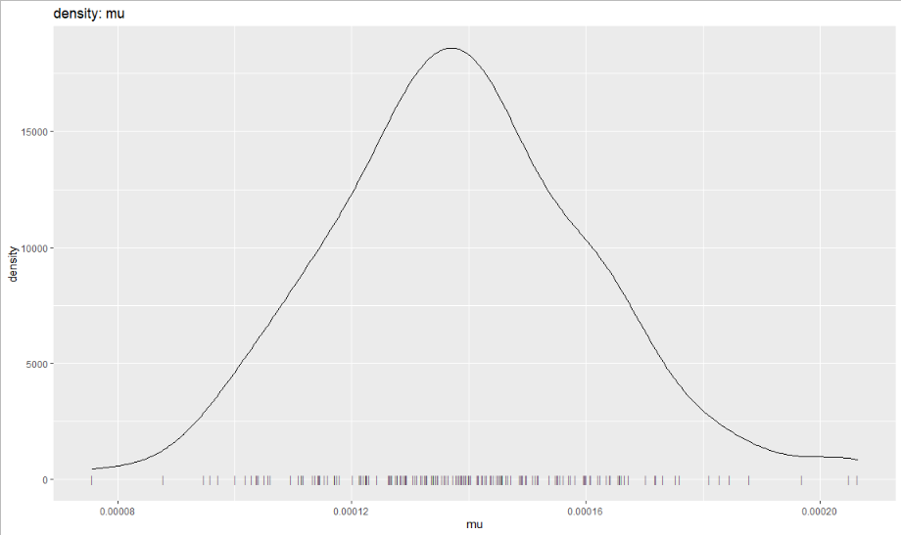
Some Results
Trace Plots
Posterior Density

Slide 31
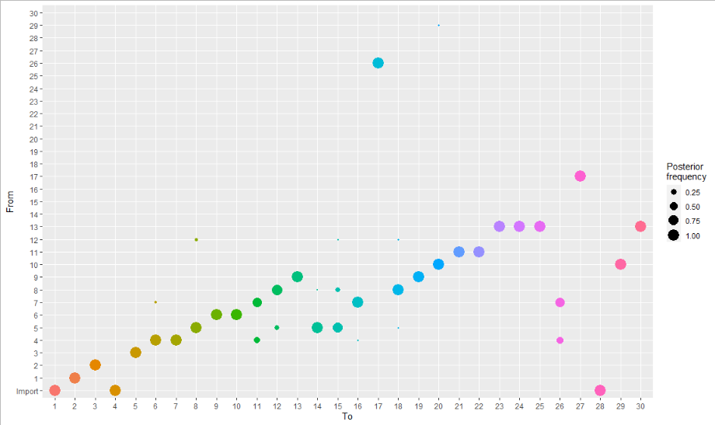
SOME MORE INFERENCE
Alphas (posterior probabilities of transmission from a -> b)

Slide 32
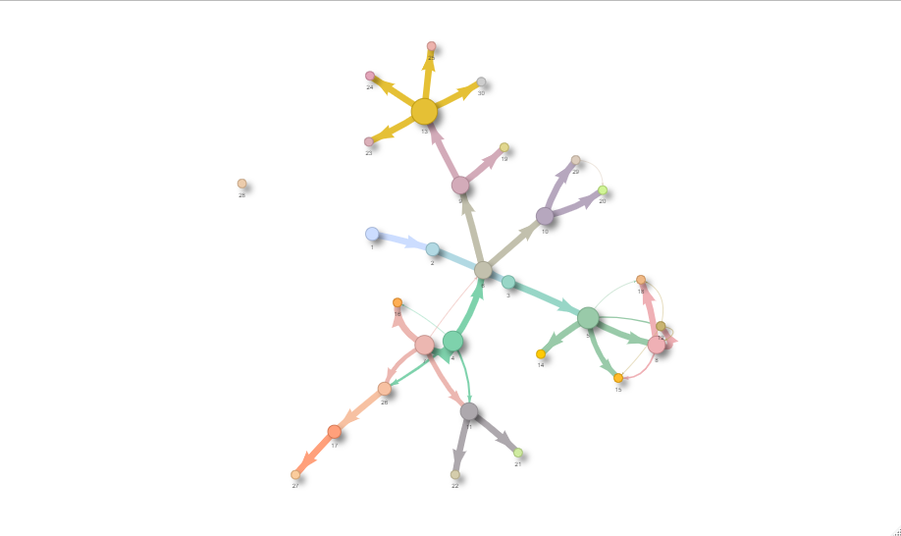
Inferred Outbreak Network

Slide 33
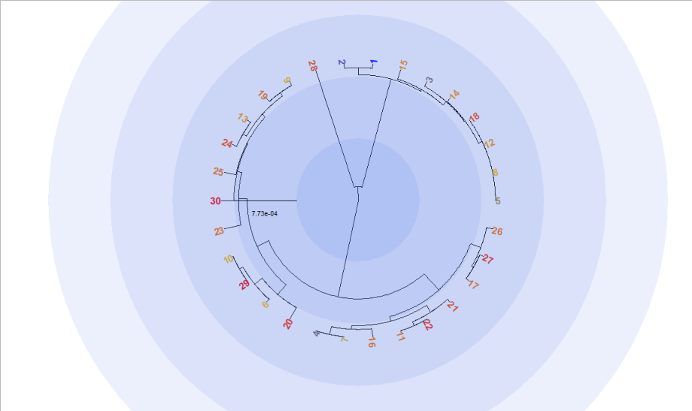
Similarities
28 is an outlier
Two major branches with similar sub branching

